Slide 1
6 Then I saw another angel flying in the midst of heaven, having the everlasting gospel to preach to those who dwell on the earth—to every nation, tribe, tongue, and people— 7 saying with a loud voice, “Fear God and give glory to Him, for the hour of His judgment has come; and worship Him who made heaven and earth, the sea and springs of water.”
Revelation 14;6,7 NKJV

Slide 2
26 October 2019

Slide 3
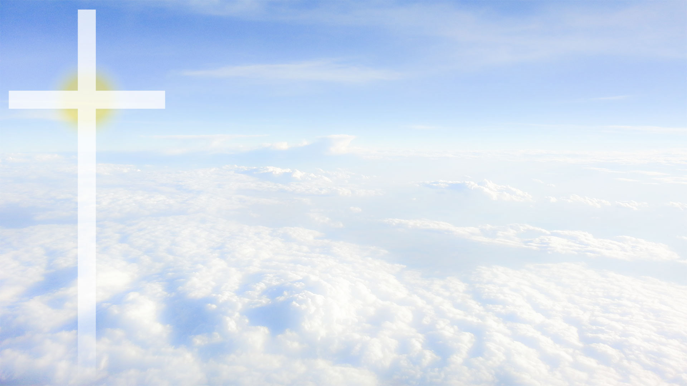
The Bible, The Creation and The Reformation
Creation Sabbath
October 26, 2019
Timothy G. Standish, PhD

Slide 4
Scripture:
But we see Jesus, who was made a little lower than the angels, for the suffering of death crowned with glory and honor, that He, by the grace of God, might taste death for everyone.
For it was fitting for Him, for whom are all things and by whom are all things, in bringing many sons to glory, to make the captain of their salvation perfect through sufferings. For both He who sanctifies and those who are being sanctified are all of one, for which reason He is not ashamed to call them brethren,
Hebrews 2:9-11 NKJV

Slide 6
The Bible, The Creation and The Reformation
Creation Sabbath
October 26, 2019
Timothy G. Standish, PhD

Slide 9
“They preach only human doctrines who say that as soon as the money clinks into the money chest, the soul flies out of purgatory.”
Notes:
“Menschenlehre verkündigen die, die sagen, daß die Seele (aus dem Fegefeuer) emporfliege, sobald das Geld im Kasten klingt.”

Slide 12
Sola Scriptura

Slide 13
“The true treasure of the church is the most holy gospel of the glory and grace of God.”
Notes:
“Der wahre Schatz der Kirche ist das allerheiligste Evangelium von der Herrlichkeit und Gnade Gottes.”

Slide 15
Sola Scriptura

Slide 16
The Bible is a record of God’s actions throughout history—past, present and future—and that is good news!

Slide 17
Unique Attributes of Scripture
Unique attestation independent of itself
Unique wisdom
Unique perspective on human nature and value
Unique good news
Unique path to salvation
Unique form of worship
Unique power to change human lives for the better

Slide 18
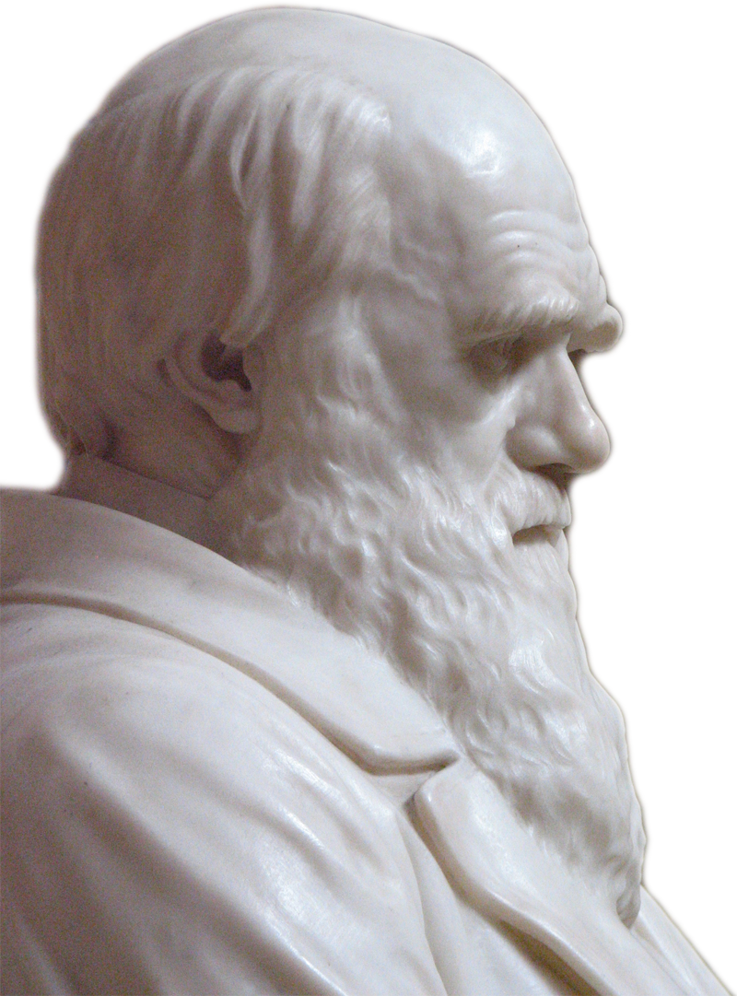
Humans =
Genetics
(Nature)
+
Environment
(Nurture)

Slide 19
“Most assuredly, I say to you, whoever commits sin is a slave of sin. And a slave does not abide in the house forever, but a son abides forever.
Therefore if the Son makes you free, you shall be free indeed.”
John 8:34-36 NKJV

Slide 20
And you shall know the truth, and the truth shall make you free.
John 8:32 NKJV

Slide 21
Jesus said to him, “I am the way, the truth, and the life. No one comes to the Father except through Me.
John 14:6 NKJV

Slide 22
All things were made through Him, and without Him nothing was made that was made.
John 1:3 NKJV

Slide 23
He who does not love does not know God, for God is love.
1 John 4:8 NKJV

Slide 24
“Behold, the virgin shall be with child, and bear a Son, and they shall call His name Immanuel,” which is translated, “God with us.”
Matthew 1:23 NKJV

Slide 25
And I will pray the Father, and He will give you another Helper, that He may abide with you forever—the Spirit of truth, whom the world cannot receive, because it neither sees Him nor knows Him; but you know Him, for He dwells with you and will be in you. I will not leave you orphans; I will come to you.
John 14:16-18 NKJV

Slide 26
Behold what manner of love the Father has bestowed on us, that we should be called children of God! Therefore the world does not know us, because it did not know Him.
1 John 3:1 NKJV

Slide 27
Therefore, if anyone is in Christ, he is a new creation; old things have passed away; behold, all things have become new.
2 Corinthians 5:17 NKJV

Slide 28
“When Moses writes that God created heaven and earth and whatever is in them in six days, then let this period continue to have been six days, and do not venture to devise any comment according to which six days were one day. But, if you cannot understand how this could have been done in six days, then grant the Holy Spirit the honor of being more learned than you are…
Notes:
(What Luther Says. A Practical In-Home Anthology for the Active Christian. Compiled by Ewald M. Plass. St. Louis, Missouri: Concordia 1959. p 1523.)

Slide 29
…For you are to deal with Scripture in such a way that you bear in mind that God Himself says what is written. But since God is speaking, it is not fitting for you wantonly to turn His word in the direction you wish to go.”
Martin Luther
Notes:
(What Luther Says. A Practical In-Home Anthology for the Active Christian. Compiled by Ewald M. Plass. St. Louis, Missouri: Concordia 1959. p 1523.)

Slide 30
“I believe in God the Father Almighty, Maker of heaven and earth.”
Martin Luther
Notes:
(Martin Luther. The Large Catechism. Translated by F. Bente and W.H.T. Dau. Published in: Triglot Concordia: The Symbolical Books of the Ev. Lutheran Church. St. Louis: Concordia Publishing House, 1921. pp. 565-773)

Slide 32
Benediction:
Now to Him who is able to establish you according to my gospel and the preaching of Jesus Christ, according to the revelation of the mystery kept secret since the world began but now made manifest, and by the prophetic Scriptures made known to all nations, according to the commandment of the everlasting God, for obedience to the faith—to God, alone wise, be glory through Jesus Christ forever. Amen.
Romans 16:25-27 NKJV

